Slide 1
Group 8: Văn Quang Hoàng Phúc Anh Tài
TOPIC 12: GIT

Slide 2
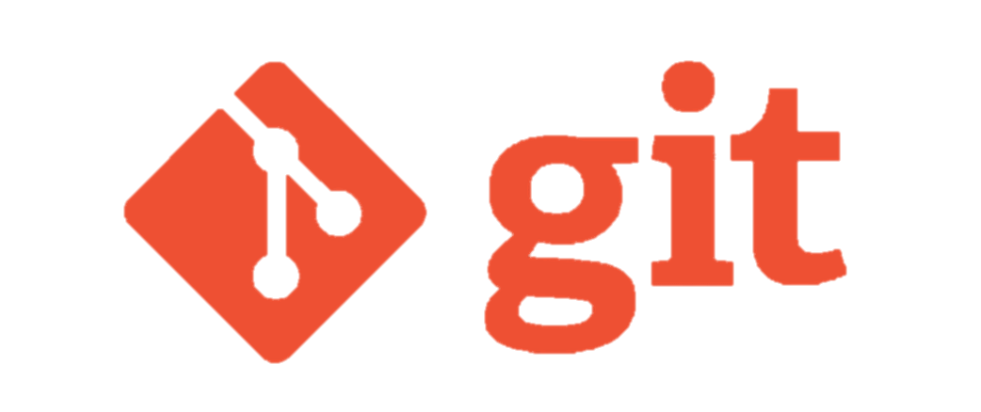
What is GIT ?

Slide 3
WHY USE GIT ?
Performance:
Security:
Branching Model:
Open Source:

Slide 4
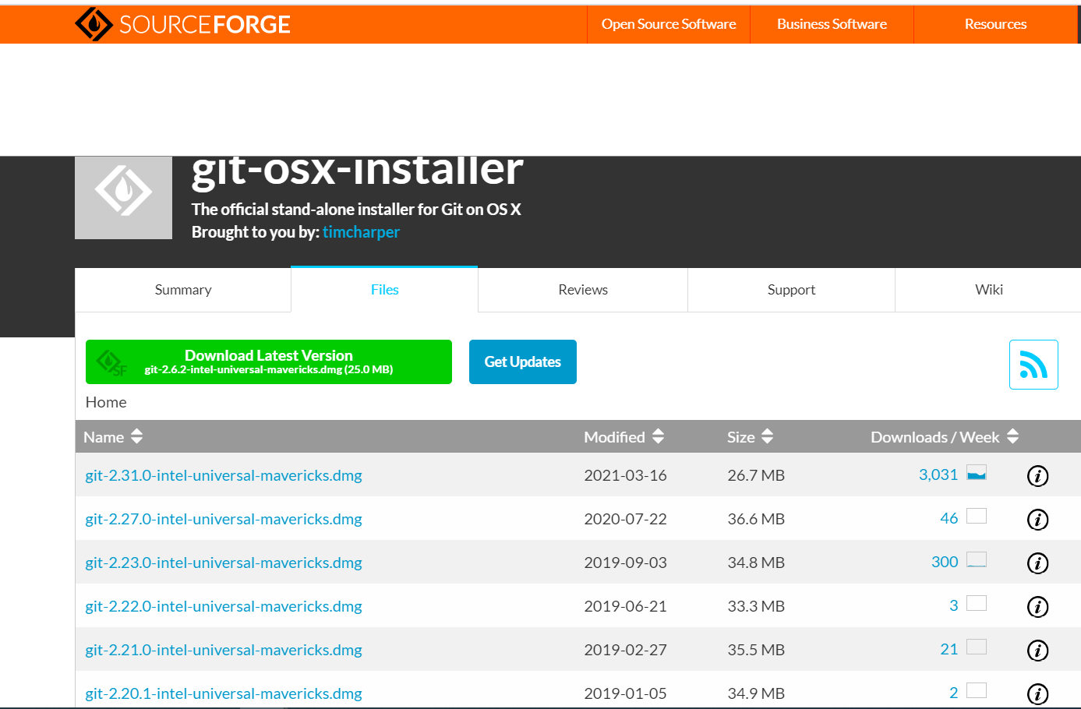
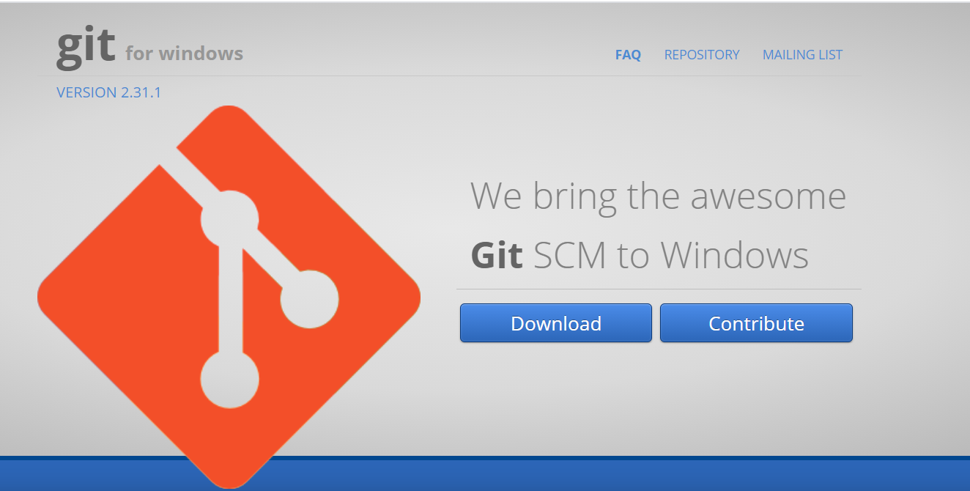
DOWNLOAD AND INSTALL GIT
Install GIT for mac. https://sourceforge.net/projects/git-osx-installer/files/?fbclid=IwAR2oajJLhNOTuohHsNCdDM1xT5T12D5QVR7E_WTAse0deSIvBL4vSolM6l8
Install GIT for Window https://gitforwindows.org/

Slide 5
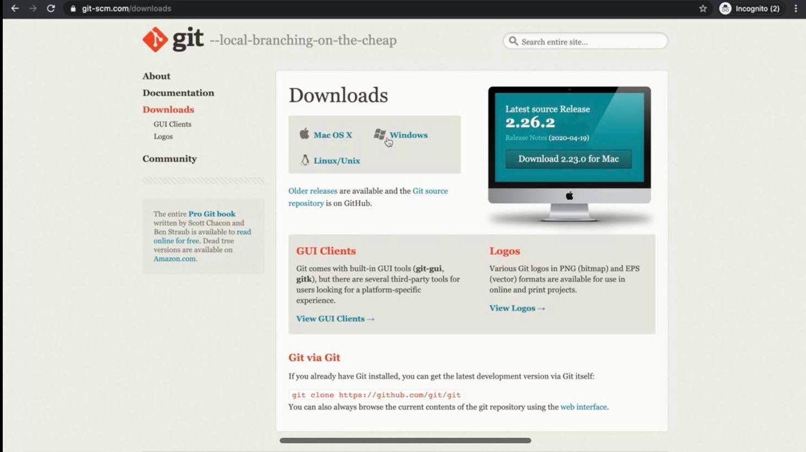

Slide 6
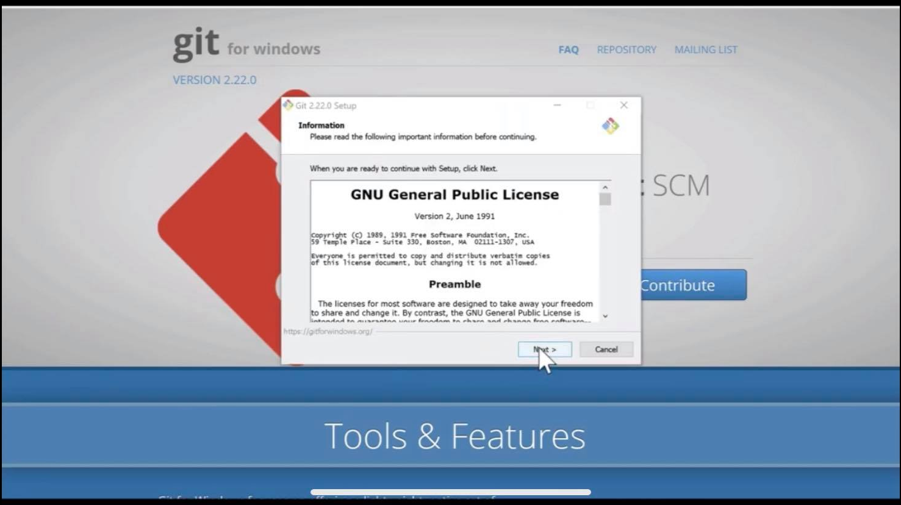

Slide 7
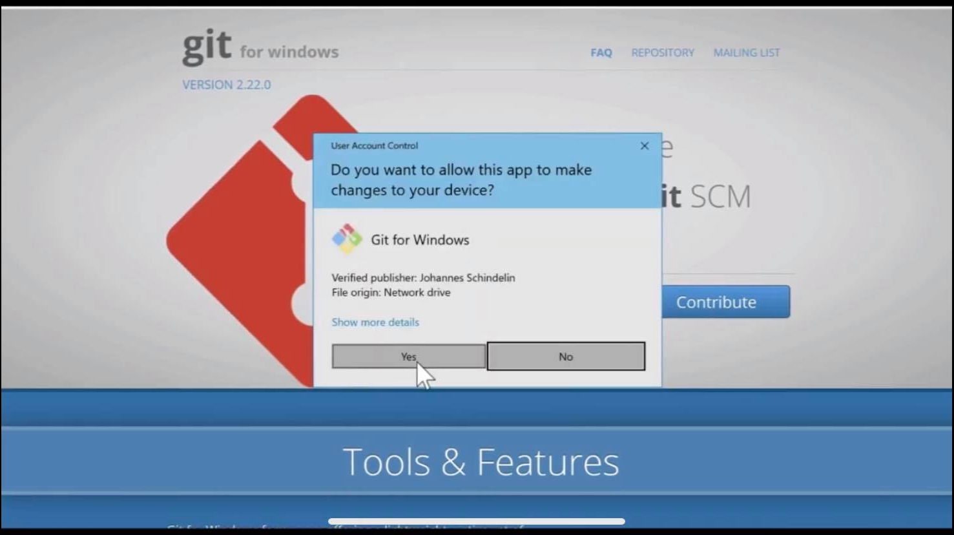

Slide 8
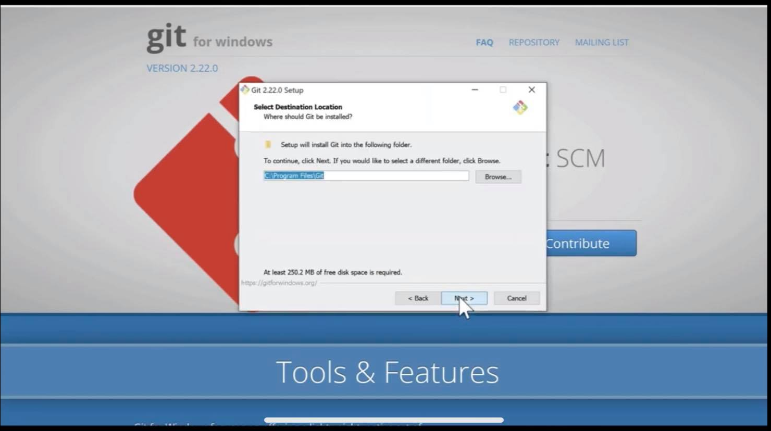

Slide 9
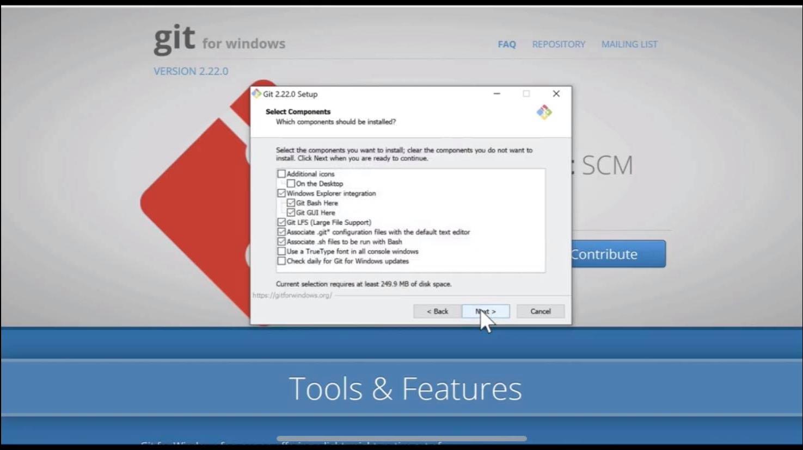

Slide 10
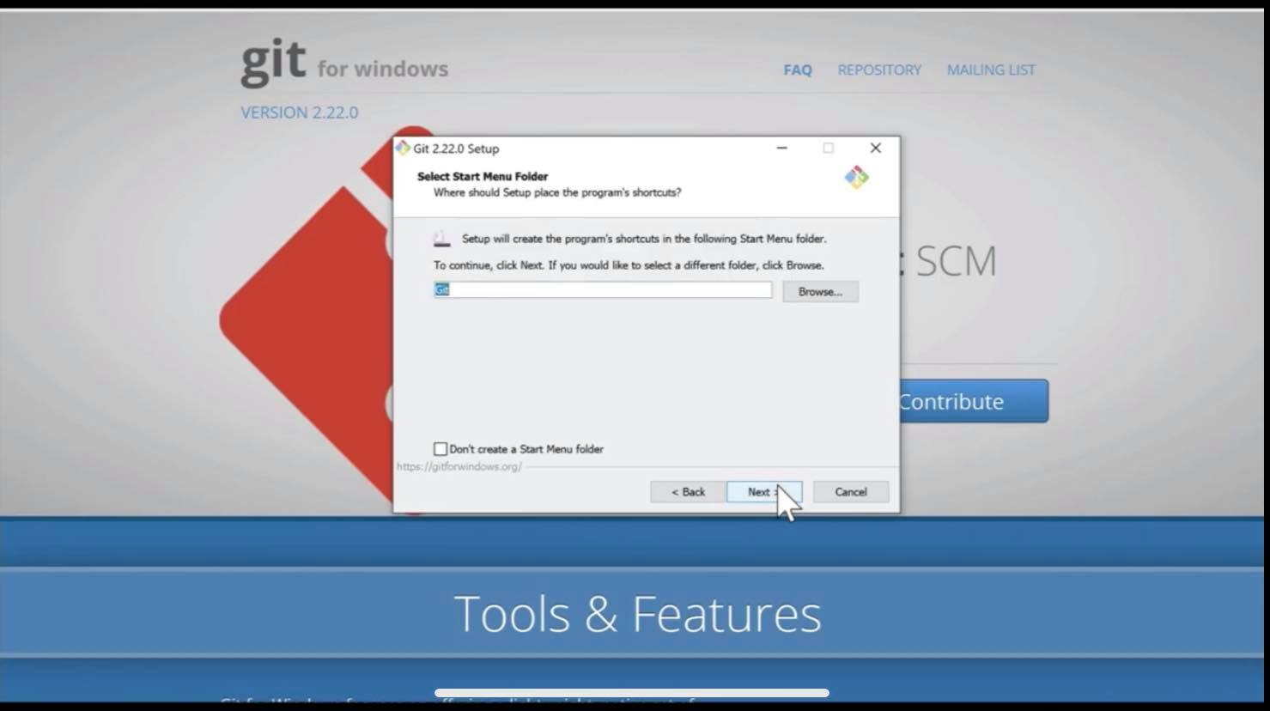

Slide 11
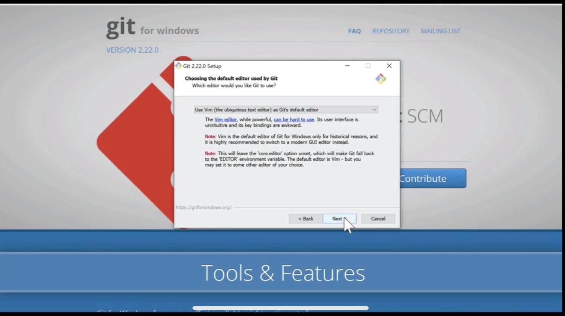

Slide 12
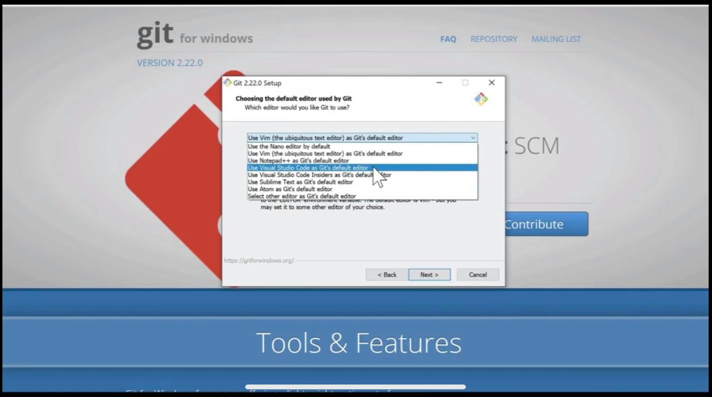

Slide 13
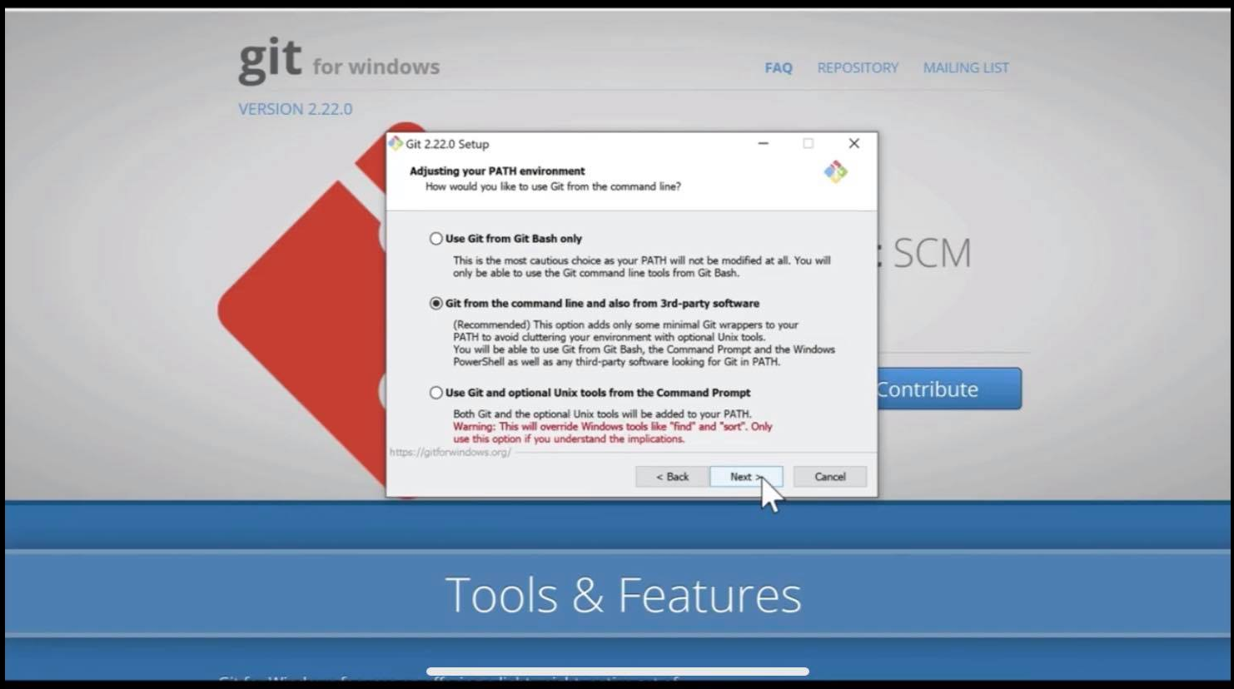

Slide 14


Slide 15


Slide 16
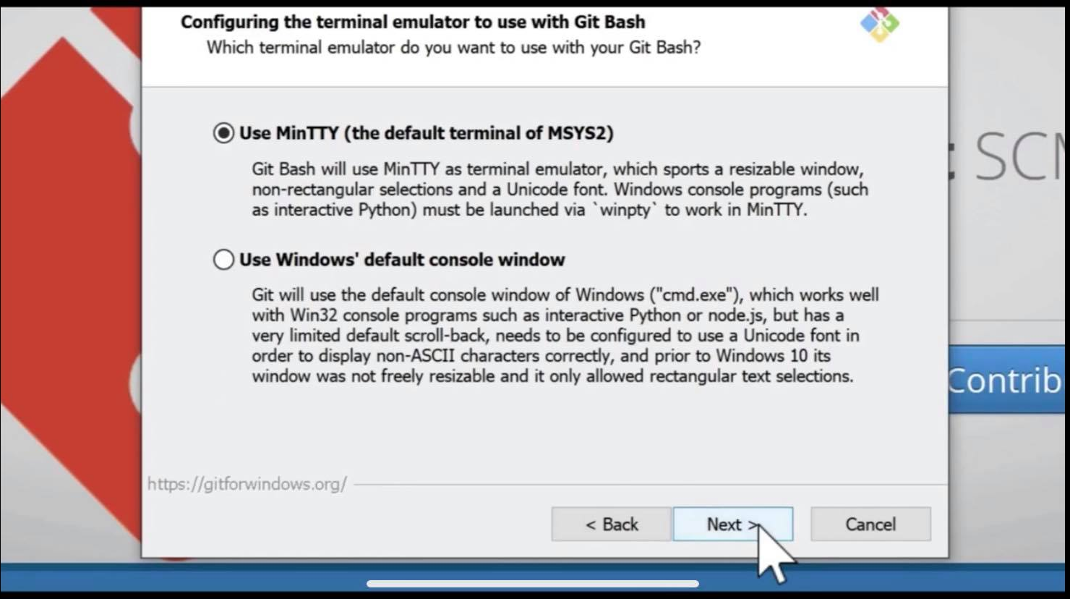

Slide 17
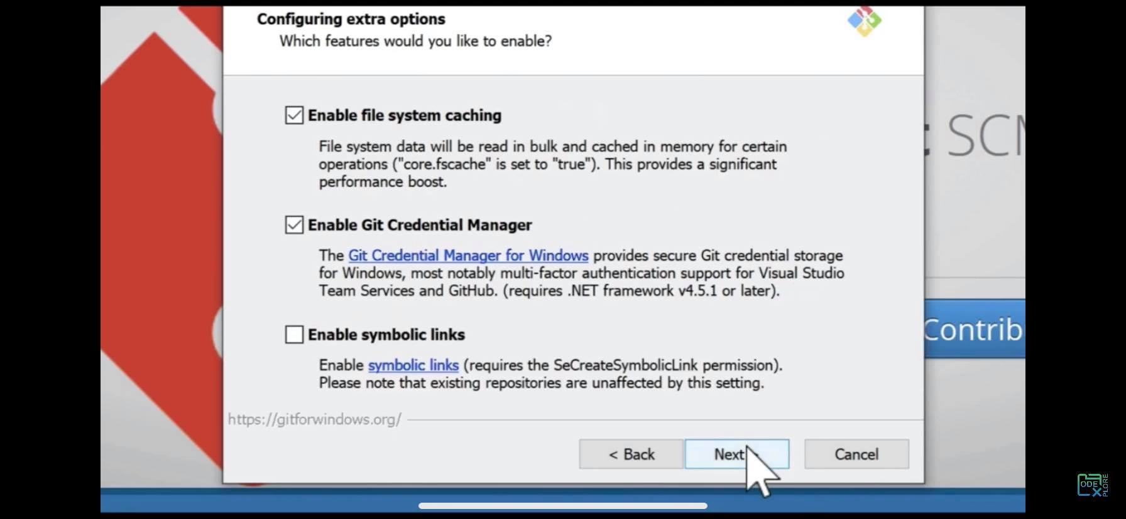
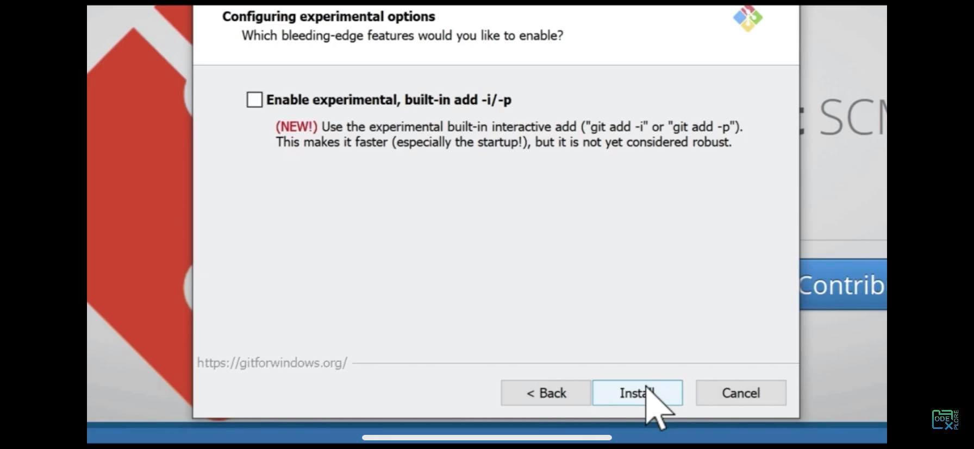

Slide 18
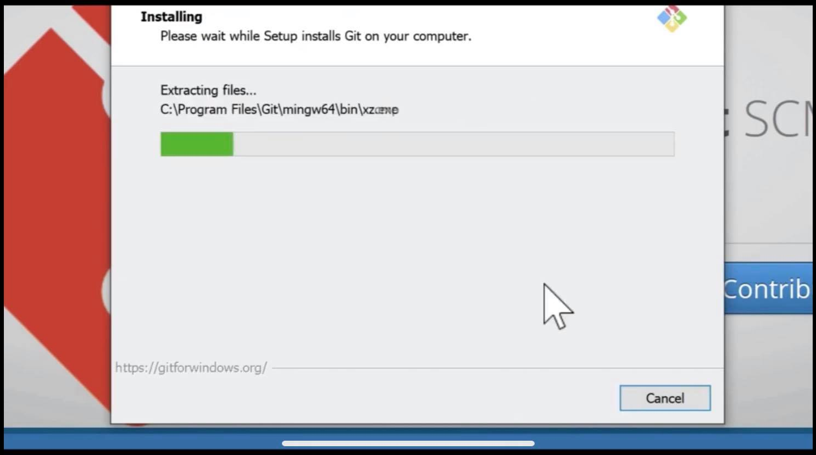

Slide 19
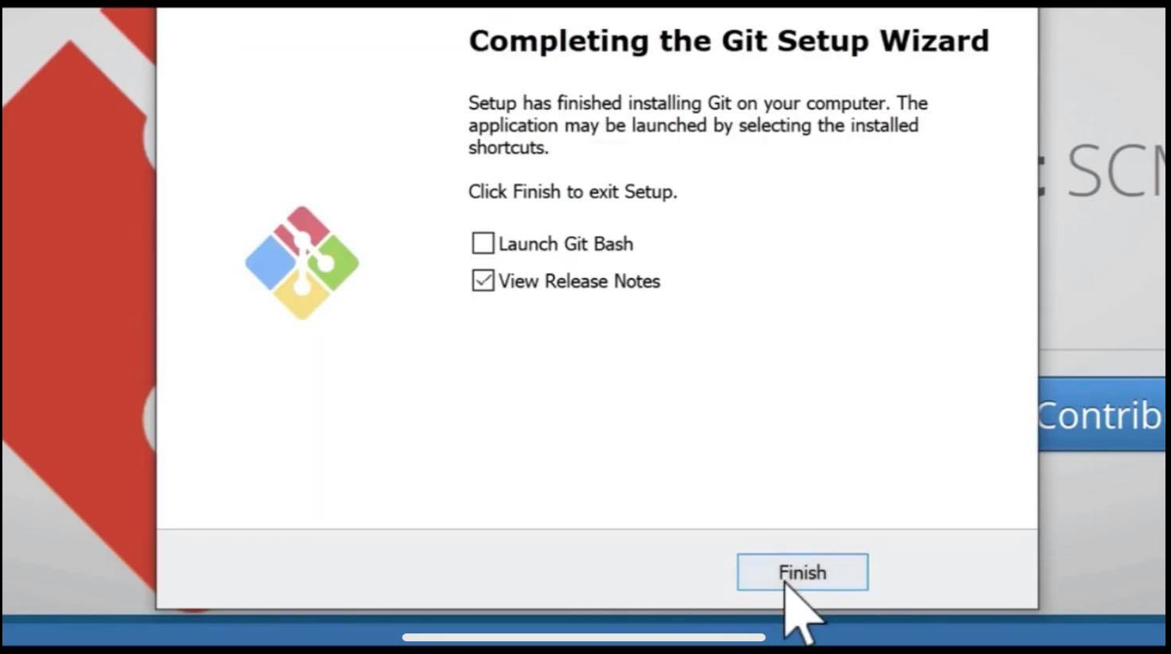

Slide 20
Version control systems
What is Version control systems?

Slide 21
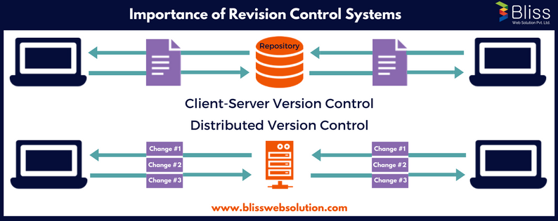
Importance of Version Control System

Slide 22
Some well-known version control systems:
CVS and Subversion use a “central” repository; users “check out” files, work on them, and “check them in”
Mercurial and Git treat all repositories as equal
→ Distributed systems like Mercurial and Git are newer and are gradually replacing centralized systems like CVS and Subversion

Slide 23
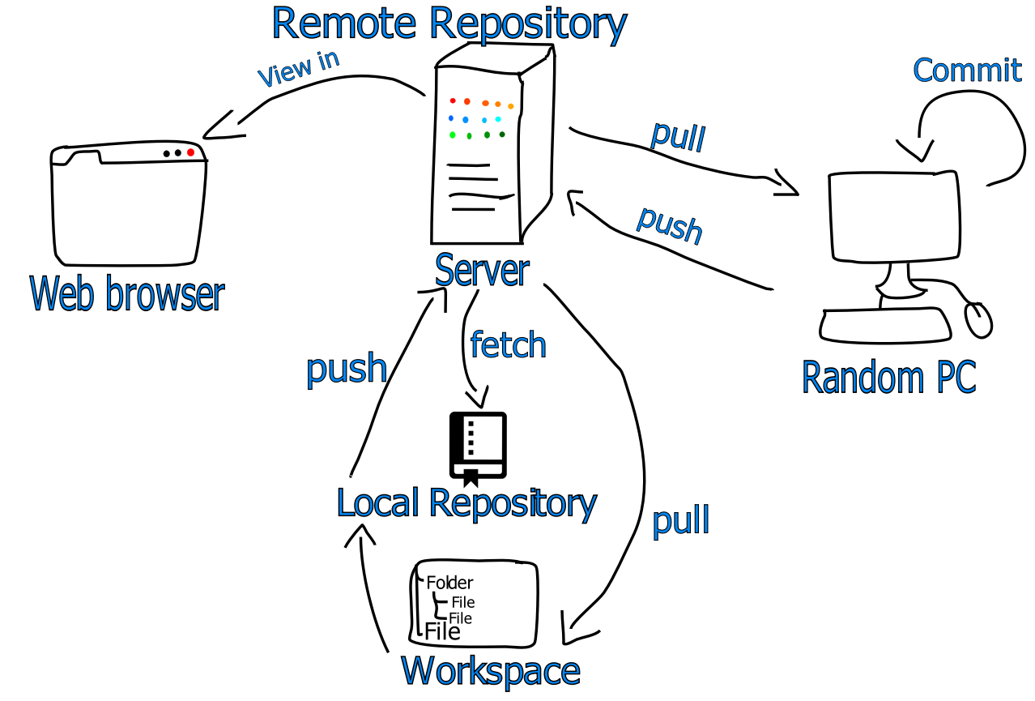
SOME TERMINOLOGIE
Repository
Commit
Branch
Push
Pull
Fetch
Checkout Revision

